Slide 1
CMU Rental Hub BIS 698 Information Systems Project
By Group 9
Krishna Mohan Reddy Ailuri
Himabindu Mandem
Sai Prasanna Goduguluri
Sainikhil Reddy Pannala
Prahlada Reddy Kasani
Notes:
Prasanna Hello executives.
We are Group 9, and today we’re excited to present our BIS 698 Information Systems Project the CMU Rental Hub.

Slide 2
Agenda
Background
Problem / Opportunity
ERD
Context Level DFD
Level 0 and Level 1 DFD
System Overview
Notes:
Prasanna This presentation covers the project background, problem statement, ERD, DFDs (Context, Level 0 & 1), and a system overview including key features and interfaces. Let's begin with the background.

Slide 3
Background
CMU Rental Hub supports students with temporary item rentals.
Students can borrow appliances, monitors, furniture, and more.
Helps new students settle without buying expensive items.
Reuses unused university resources efficiently.
Saves students money and minimizes waste.
Notes:
Prahalad The CMU Rental Hub was created to help students, especially new ones, rent items they need temporarily. Things like appliances, monitors, and furniture are made easily available. Instead of buying everything, students can borrow items and save money. At the same time, the university can make good use of resources that would otherwise sit unused. This way, both students and the campus benefit.

Slide 4
Problem / Opportunity
Students stay temporarily for 1.5–2 years.
Buying new items for short-term use is costly.
No simple rental option available for needed items.
Renting saves money and is more practical for students.
Opportunity to reuse university-owned resources smartly.
Our solution: Build a rental web app to help more students.
Notes:
Prahalad As students, we realized we are here only for about one and a half to two years. Buying brand new items like furniture, monitors, or appliances just for short-term use felt like a big waste of money. Plus, there was no easy rental option available. That’s why we thought of creating this web application. It would allow students to rent things for a small amount, save money, and make use of university resources that would otherwise stay unused.

Slide 5
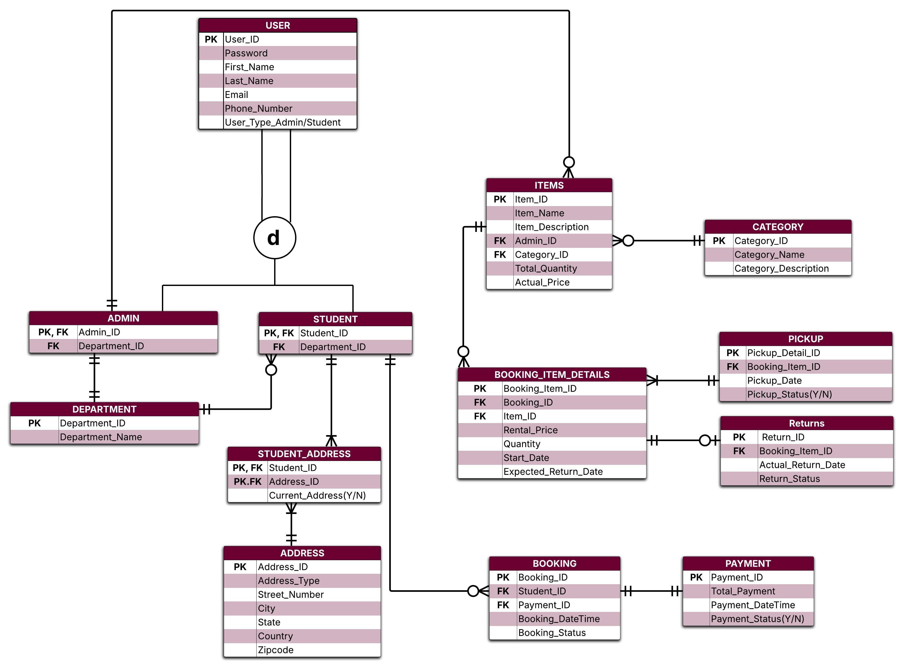
ERD
Notes:
Nikhil This is our Entity-Relationship Diagram. It shows how all the tables in our database are connected. At the core, we have the User table which splits into Student and Admin. Items are linked to both admin and category, and every booking is tied to a student and a payment. We also track what items were booked, when they were picked up, and when they are returned. It looks complex but helps us keep everything organized and reliable.

Slide 6
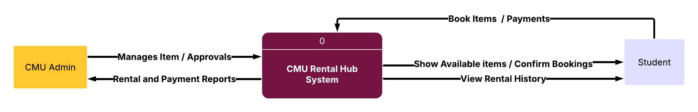
DFD – Context Level
Notes:
Krishna Mohan This is our context-level Data Flow Diagram. It shows how the CMU Rental Hub system connects with both admins and students. Admins manage inventory, approve rentals, and track payments, while students can search for available items, book them, and view their rental history. The arrows show how information flows back and forth, making the system easy to use and keeping all actions transparent for both sides.

Slide 7
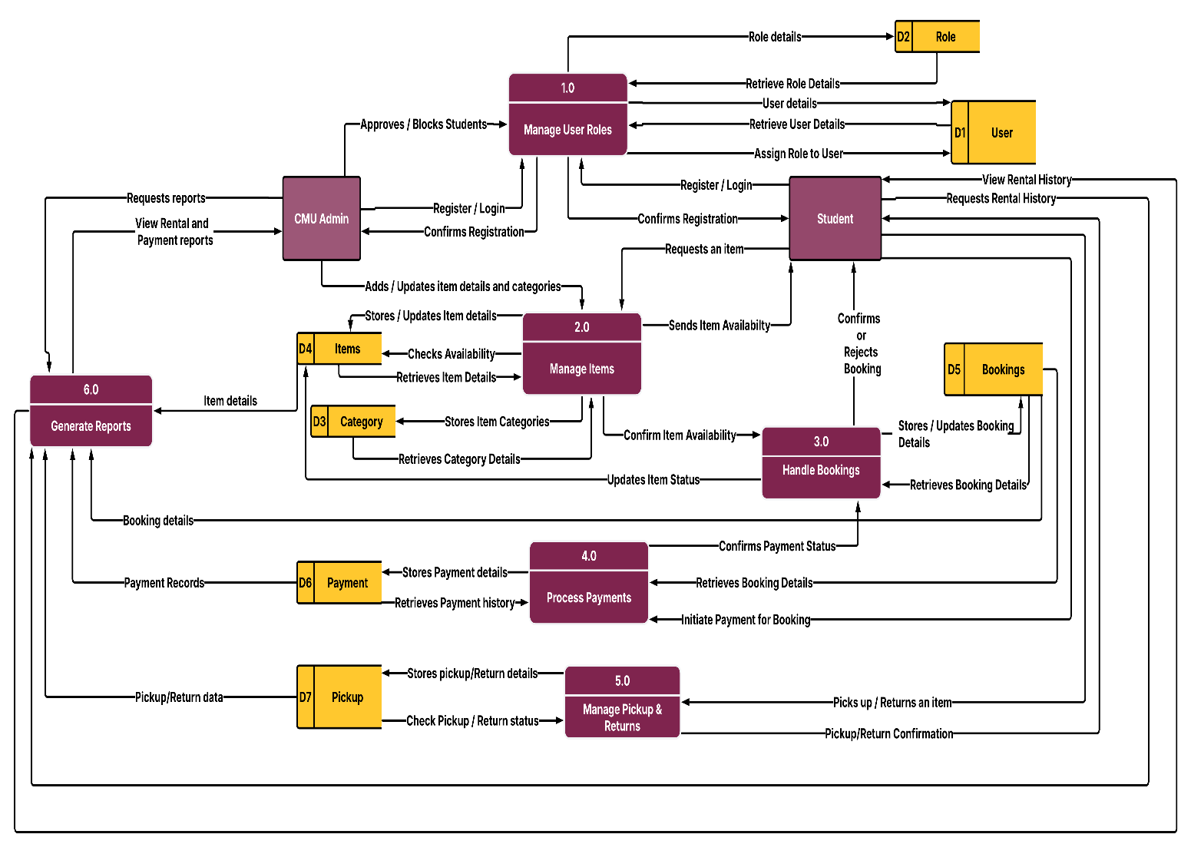
DFD – Level Zero
Notes:
Bindu This is the Level 0 Data Flow Diagram of the CMU Rental Hub system, which outlines the six main processes that handle user roles, item management, bookings, payments, pickups/returns, and report generation. Admins manage inventory, approve users, and generate rental/payment reports, while students can register, view items, place bookings, and make payments. Each process interacts with specific data stores like Users, Items, Categories, Bookings, Payments, and Pickups to ensure smooth data flow and efficient rental management.

Slide 8
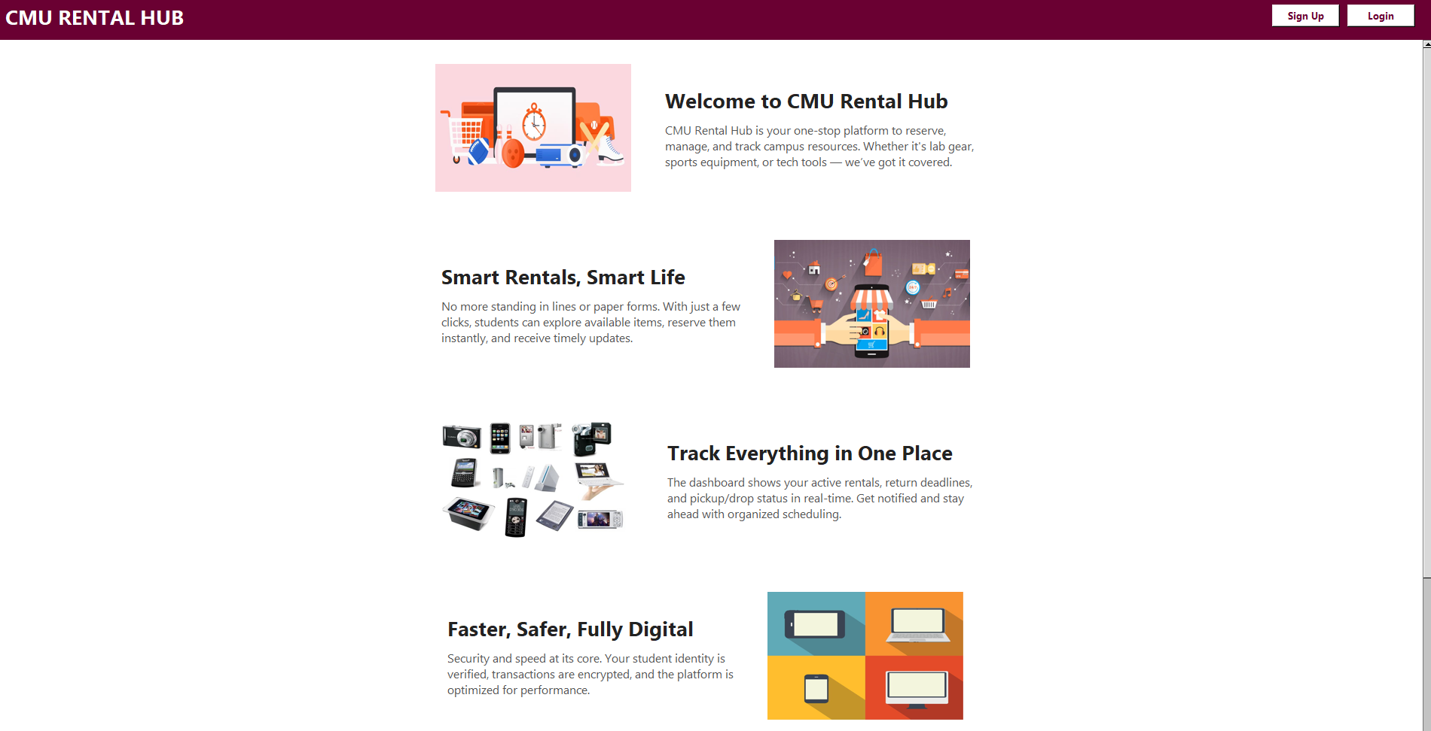
Welcome Screen

Slide 9
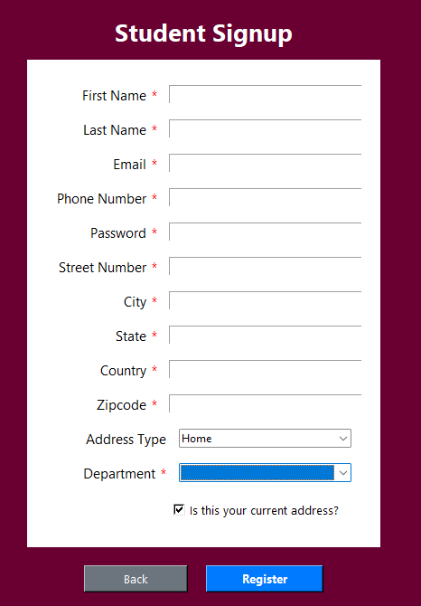
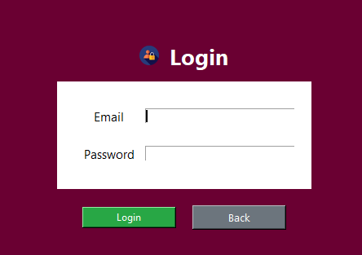
Sign up / Login

Slide 10
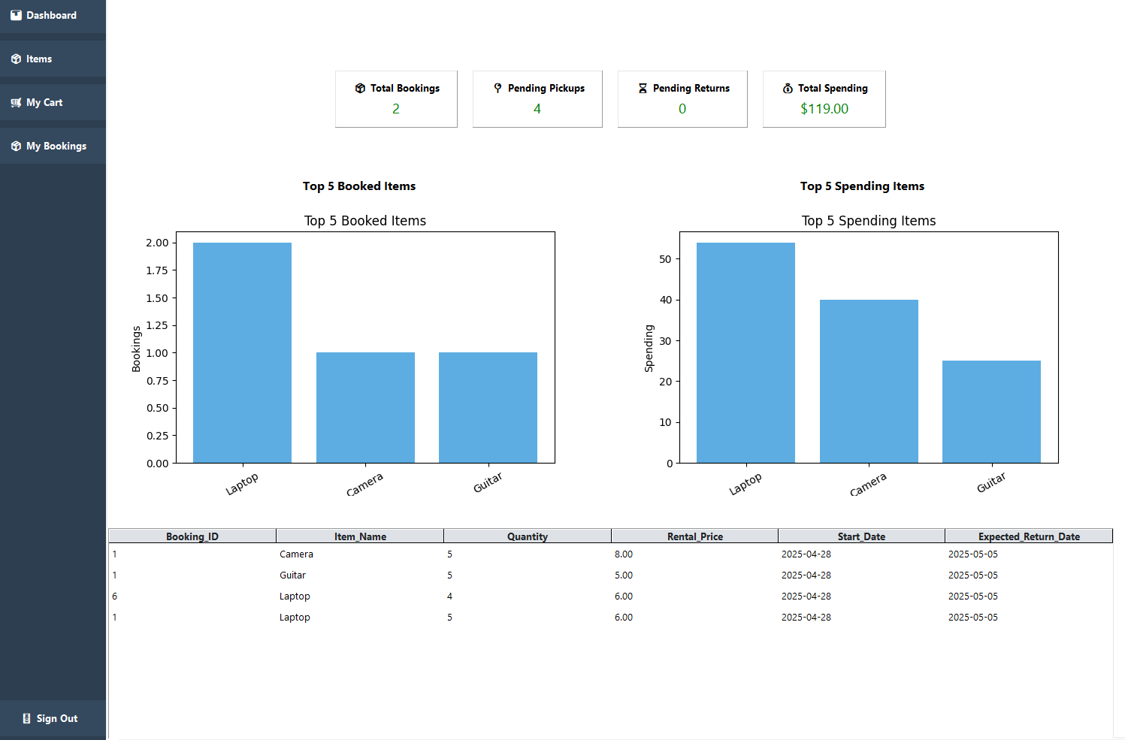
Student Dashboard

Slide 11
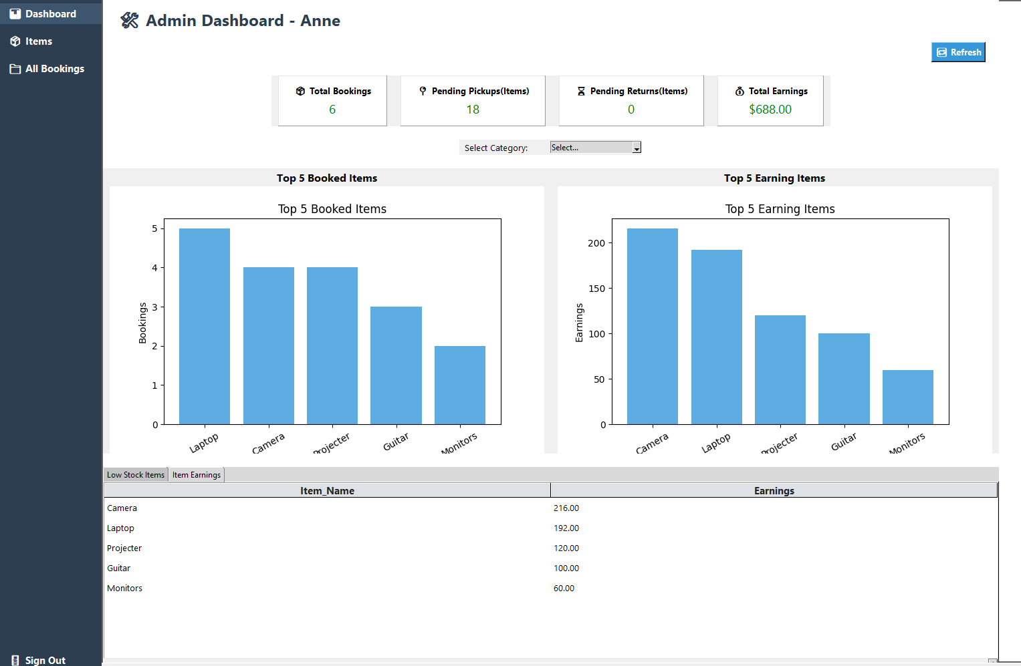
Admin Dashboard

Slide 12


